Slide 1
TCGA and TARGET Lessons Learned
Presentation to the GDC team
July 1, 2014
U. Chicago, OICR, NCI, Leidos

Slide 2
Agenda
Introduction
Purposes
Format of this presentation
Object model
Lessons learned
Annotation DB
Other topics
Concluding discussion

Slide 3
Purposes
Of this presentation:
Present TCGA and TARGET lessons learned where the data service delivery limitation was tightly coupled to technical implementation decisions.
Of the GDC: is to provide a data service, to:
The science community
Management, who has both science and fiduciary responsibilities to the taxpayer (See LL1, LL6)

Slide 4
Format of this presentation
This is intended to be a discussion
If subject is brought up which is OBE, stop me.
Where you see the word “Recommendation”, it is intended to open debate.

Slide 5
Background info
Object model
Term ‘object’ used in IT context, being any entity (real or conceptual) that should be modeled in the information system.

Slide 6
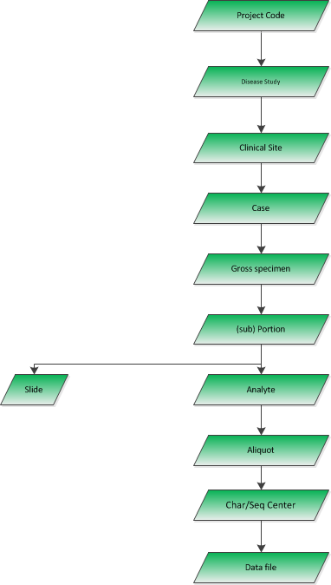
Object model
Typical TCGA structure
In TCGA, every aliquot and data file had to have this ENTIRE structure above it.

Slide 7
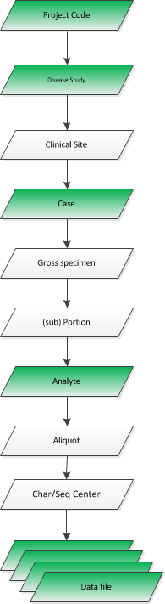
Object model
Typical TARGET structure
More sparse
No individual aliquots per data file

Slide 8
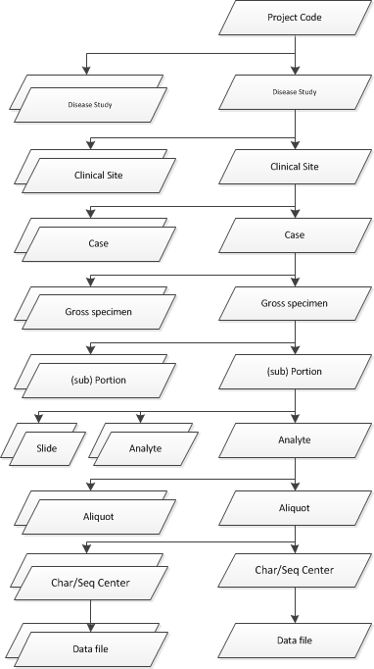
Object model: Big data vs. complicated data
Images
BAMs

Slide 9
Object model: Big data vs. complicated data
Complex
Variable per situation
Variable over time
Messy / errors
Small

Slide 10
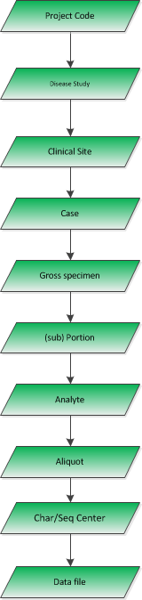
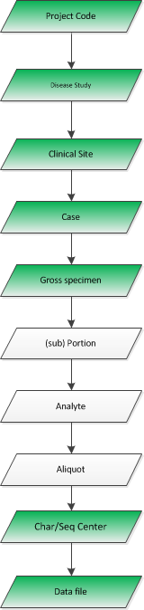
LL0: When the object doesn’t fit the ER hierarchy
TCGA started proteomics
Tissue samples became shipped objects
Model only allowed aliquots of NA to be ship-able.

Slide 11
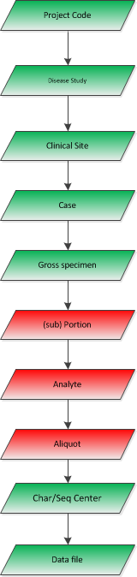
LL0: When the object doesn’t fit the ER hierarchy
TCGA started proteomics
Tissue samples became shipped objects
Create fake objects

Slide 12
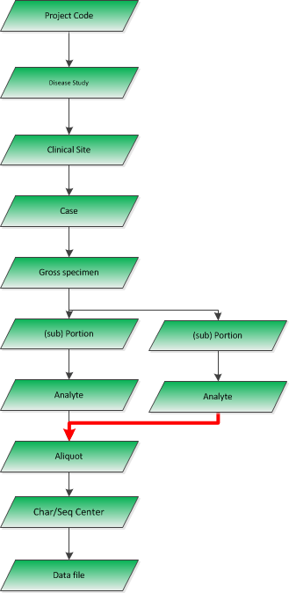
LL0: When the object doesn’t fit the ER hierarchy
Sample pooling
Multiple specimens or portions or analytes were combined to create a single ship-able aliquot.

Slide 13
LL0: Rigid hierarchy in ER
Recommendation
Parent child relationships are important
Counting objects
E.g. case completion: for which cases are data complete, are characterizations complete?
Object relationships
E.g. give me DNA BAM files on female LUAD patients still alive where there are RNAseq BAMs and some residual tissue
Graph DB is likely the best way to reflect cancer genome project complexity

Slide 14
LL1: Log everything via unified system
CCG programs are expected to be able to report on usage: queries and download.
TCGA DCC:
Routed queries and downloads through different systems with different levels of logging kept by different administrative entities:
REST API, Tomcat (standalone)
Apache
FTP, HTTPS

Slide 15
LL1: Log everything via unified system
Don’t worry about too much logging, just be accurate. “big data” analytics has big logs solved in industries generating CCG data quantities daily.
GDC has some reporting requirements in SOW
Unspecified reports / data mining can wait based on CCG need, but underlying data need to be there at the start.
Recommendation:
Implement single stream detailed logging at net interface and application levels (i.e. log4j, py Logger) short of DEBUG level).
Action item: provide GDC with copy of recent Battelle log analysis

Slide 16
LL2: Categorization of objects into more than one group
Rigid ER model forced objects into a single category, when in reality they belonged in multiple categories :
A case could only belong to one disease study
A disease study could only belong to one project
There was one project: TCGA
Any of a case’s children could only inherit from above.
All data submissions, user queries and data retrieval was forced into these single category lines

Slide 17
LL2: Categorization of objects into more than one group
Use case 1:
Pilot study Chernobyl thyroid cancer cases were done under TCGA project
Now we have an REBC (Chernobyl-specific) project.
Cannot put pilot study TCGA cases into REBC project too.

Slide 18
LL2: Categorization of objects into more than one group
Use case 2:
Non-cancer patient (“normal”) brain samples obtained to be expression controls for GBM disease study
4 yrs later, TCGA starts a lower grade glioma (LGG) disease study
Normal brain samples a valid for LGG too
Normal brain samples could not also be categorized into the LGG study

Slide 19
LL2: Categorization of objects into more than one group
Use case 3:
TCGA does pilot study to compare DNA/RNA seq data between FFPE and Frozen samples from same case
Samples were from cases from multiple disease studies: LUAD, COAD, READ, OV, etc.
Users want to see single study holding these materials
No way to keep these cases and samples in their original groups AND SIMULTANEOUSLY in a new FFPE/Frozen comparison study category

Slide 20
LL2: Categorization of objects into more than one group
Recommendation:
Concepts like “Project” (TCGA, TARGET, etc) or “Disease study” (LUAD, BRCA, NB) should only be metadata on objects.
What if we want more categorizations than just “Project” and “Disease study”? We do.
Also solved by GraphDB
Nodes are objects like “Case” – aka entities
EAV scheme using K:V puts “Project” or “Study” values as attributes on a node
Practical:
By the time final legacy data import happens, the BCR XML will reflect all of the above use cases

Slide 21
LL3: Rapid iteration on data models
(This OBE, but…)
Most data files coming into TCGA DCC were decomposed (“shredded”) into an RDBMS.
Many of these files are not natively relational: XMLs, MAGE-TABs
Complex tables (many join tables) and app-layer dependencies
Community was able to iterate on these file formats faster than DCC could keep up with them all
Recommendation:
Use persistence DBs native to the data type

Slide 22
LL4: Data access policies
What constitutes data that need to be restricted access?
It changes, frequently.

Slide 23
LL4a: User authorizations hard-coupled to systems and data
TCGA and TARGET DCC hard-couples user authorization / data visibility to:
File type, data type, data source, FS location, etc.
One column in the RDBMS that is a boolean: isVisible
But not to:
Metadata categorizations (e.g. REBC vs TCGA)
Independent variables (metadata, K:V pairs) specific to authorization
Problem: User authorization reqs change frequently, based on:
Policy changes
Content changes
Recommendation: user authorizations should not be hard-tied to characteristics of the data type, file format, data location, data source, etc. They should be separate, independent variables:
Such variables can be (un)set by policy-driven software, but
changed almost arbitrarily, with granularity, as needed.
(GDC already doing this) Every object, file, archive, etc. should be part of an object ID store to which authorization variables can be attached

Slide 24
LL4b: PII and PHI
Examples:
PHI and clinical data:
HIPAA changes what content no longer regulated
Project policy changes what content is included or excluded
Genotypic data
Birdseed files were not, then were.
Variants in tumor DNAseq: now only when filtered
Changes are frequent, will be continual, and sometimes seemingly capricious
Recommendation:
Don’t hard-couple authorizations to characteristics of the data
Authorizations should be separate variables that can be independently tuned.

Slide 25
LL4c: Files and access restriction
nationwidechildrens.org_LGG.bio.Level_1.112.10.0.tar.gz
Data files as submitted to DCC and GDC
Archives
Individual files
Decomposed data
File and data access restriction based on descendent genealogy is not valid.
nationwidechildrens.org_biospecimen.TCGA-CS-6290.xml
nationwidechildrens.org_clinical.TCGA-CS-6290.xml
<days_to_birth>-3652</
<day_of_birth>30</
<month_of_birth>6</
<year_of_birth>2004</

Slide 26
LL4d: Access policy based on file format (Zhining)
TCGA implemented a policy that variant files:
VCF: would contain somatic AND germline variants
Ergo: restricted access
MAF: could contain somatic OR somatic + germline variants
Ergo: Restricted access or not, depending…
Open access indication is part of filename: *.somatic.maf
Even other distribution restrictions (both open access), based on whether somatic calls are automatic vs. curated
Problems:
Such distinctions are not native to the file format
Current formats do not permit files to “self identify” as to whether they have content that might limit access
Large, extended community not necessarily cognizant of this policy decision
Analysts created and submit variant files that differed from policy

Slide 27
LL4: Data access policies
Recommendation:
Don’t hard-couple authorizations to characteristics of the data
Authorizations should be separate variables that can be independently tuned.
Policies to set authorization variables can be implemented in app layers, but
Authorization variables should be editable by multiple means
Authorization variables should be assigned to atomically to every entry in the object store.
Capable of multiple authorization variables per object.

Slide 28
LL5: Semantic barcode
Background
The barcode
Implemented the rigid object hiearchy
Semantic fields
Several fields overloaded with multiple variables
Was primary key for most years in TCGA. Still is in TARGET.
Errors were encoded, very difficult to correct
E.g. wrong sample type
<rant>The semantic barcode may be the stupidest data decision made in TCGA, TARGET</rant>

Slide 29
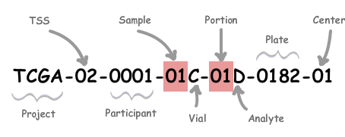

LL5: Semantic barcode
TCGA TARGET
Overloading example: sample ID (field 4):
Tumor vs. Normal
Primary vs. Primary from blood vs. Met vs. Recurrence vs. Relapse from blood
Tissue of origin: solid vs. blood vs. marrow vs. xeno
Tumor derived cell line: yes or no
Cell line control: yes or no
EBV normal
TCGA and TARGET not 100% same in meaning

Slide 30
LL5: Semantic barcode
Requirements 1:
The semantic barcode has to remain, only for humans.
For IT systems, the semantic barcode should be an ignorable, malleable piece of free-text metadata.
The system needs to be able to keep track of “original” sematic barcodes vs. the corrected semantic barcode:
Multiple “original” ones, dates of repair, etc.

Slide 31
LL5: Semantic barcode
BCR Responsibility
Old-style barcodes, their history, corrections, and assignment to a single UUID is handled by BCR and will be encoded in their XML.
It is expected that all TCGA corrections will be complete before import to GDC.
(TARGET different: no XML, no history, and corrected in a way that can be ignored by GDC.)
By time GDC is ready to ingest XML, individual fields, including overloaded fields will be broken down into unique tags with discrete meanings
GDC Requirements 2:
TARGET barcodes: will GDC need to interpret & augment it to fulfill SOW index reqs? Yes – see next slide
GDC will need to make objects findable by both original (incorrect) barcodes and the correct one.
Many incorrect barcodes got through the system, published, and broadly distributed, before being corrected.
Annotation DB replacement?
Recommendation
Regardless of where these strings are persisted, they will have to be indexed and query-able.

Slide 32
LL5: TARGET semantic barcode and Indexing
SOW section D.4.a lists indexing requirements
Many variables in this list are encoded in TARGET barcode fields, some overloaded fields
Recommendation:
??

Slide 33
LL6: Data for management and ops reporting
NCI has a responsibility to support science and watch money
DCCs, initially scoped to support science community, soon asked to include data for management reporting
Primary question across projects:
tracking of samples vs. having characterization data returned on them

Slide 34
LL6: Data for management and ops reporting
Two example situations:
What does it mean when a single aliquot of DNA has?:
4+ active available BAM files
8 suppressed (i.e. now hidden) BAM files
Aliquot accounting
By Q4 2011, TCGA had distributed >104k aliquots, but
Had received only <80k data results back
Some GSC/GCC were over 4 years tardy in returning results.

Slide 35
LL6: Data for management and ops reporting
GDC will have the data to understand such issues:
You know what aliquots have been distributed (accounts receivable)
You know what sets have been returned (payments)
Responsibilities
BCR submits AR to GDC
Battelle/Ferguson (as part of QMS) have implemented the analysis and reporting code
GDC has characterization data file inventory from Centers
GDC recommendation:
Reporting requirements in SOW include making raw data for above available
This information actually does fit well into an RDBMS
Action item:
Send GDC latest QMS “Aliquot Accounting” report

Slide 36
Annotation DB
Information about objects may change at any time
Change is continual into future
Impacts data utility in analyses
Examples:
Subject later found out to have had systemic chemo
I.e. should never have been enrolled in TCGA
Subject withdrawal
Data set will be partial
Sample was met, not primary
Impacts sample type ID and relevant science
Redaction
Subject was inappropriately consented minor
Sample was a completely different organ system
Tumor – normal genotypes don’t match
Usually caught before shipment, but…
Certain datatype will not be coming for this case
Aliquot was dropped on the floor
Library failed
(Impacts aliquot accounting: no longer in accounts receivable)

Slide 37
Annotation DB
Annotation DB
Currently, AnnoDB is a separate, standalone DB
Currently, AnnoDB is 1:n to object:entry
Currently, AnnoDB uses old-style barcode, not UUID.
So, now there are orphans, as some barcodes are corrected.
Users have to know about it, and actively seek out entries about their objects of interest to know
It is easily, frequently ignored, despite lots of “README.REALLY!!.txt” files and other exhortations
Lessons learned: AnnoDB entries:
Must be referenced via primary key (object ID, UUID) to the object(s) being annotated.
NOT old-style barcode, which can change
Must be automatically and un-ignore-ably retrieved and displayed in any data query and data retrieval
Must be N:N for objects:entries (sorry about the ER reference)
Frequently there is a single annotation that applies to many objects
Cannot be hard-tied to generation of authorizations and data visibility
E.g. just because a sample is actually from a treated vs. treatment naïve patient, we don’t want to delete or hide it. But we do want to put it into a special category: “buyer beware”
Too many details, exceptions, changes

Slide 38
Other topics
Data coming from the BCR
Forward migration of standard data formats
Q: how to implement user download of current SRA metadata XML when BAM was submitted with prior version
Tactics for bringing TARGET clinical data into GDC (Davidsen, Ferguson)
(We met last night)

Slide 39
Concluding discussion
Graph DB, with coupled EAV capability
Solves a lot of the issues above
Indexing the XML
XML -> JSON -> Elastic Search?
XML -> Solr 4.7+ -> Index -> ElasticSearch
Other?:
Status of CGCI data (Greg K.)

